Slide 1






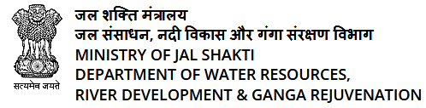
SMART INDIA HACKATHON
MINISTRY/ORGANIZATION NAME : Ministry of Jal Shakti
PROBLEM STATEMENT: Use of Digital Technology to calculate water footprints for different daily use items.
PROBLEM CODE :SIH1287
TEAM LEADER:
PROBLEM CATEGORY : SOFTWARE
THEME : Clean & Green Technology
TEAM NAME : DYNAMIC DUDES@
COLLEGE CODE : C-25248

Slide 2




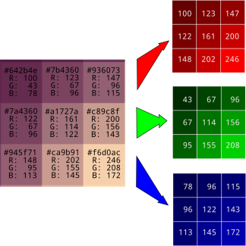


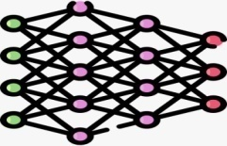

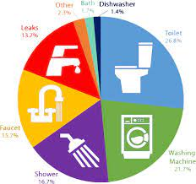
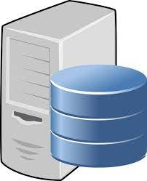


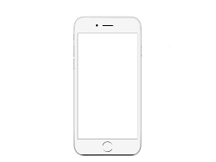


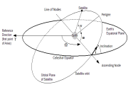
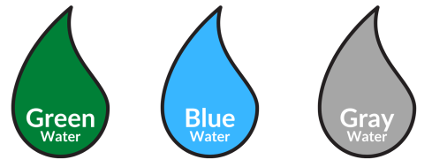

PROTOTYPE
User Provide the latitude and longitude
User Register and give Personal and Family details like Age, Gender ,City , Yearly Income, Total Number of House Hold Members
Click & Scan the Item/Product by Mobile Camera after giving the Camera Access Permission
Preprocessing ,Normalization, Localisation & Conversion of Image into Numerical Value
Provide Type & Quantity of Food Consumption Details, Dietary habit by Responding the Question Set
Training the Convolutional Neural Network (CNN) & VGGNet Deep Learning on the training dataset for Pattern Extraction & Image Recognition
Request & Response
Provide Domestic Water Use –Indoor Details by Responding the Question Set like Bath, Shower,Flush,Wash etc
Provide Domestic Water Use –Outdoor Details by Responding the Question Set like Gardening, Vehicle washing etc
Evaluating the Models performance on validation dataset using the metrics like accuracy, precision, recall and f1 score
Prepare the Labelled dataset of Item & Products in labelled format & water Availabity Dataset
Evaluate Blue water Scarcity, Sustanability & Efficiency & Suggest Tips to reduce water Footprints using Random Forest or Decision Tree
Calculate Water Footprint & Blue water Scarcity with the Help of regression & Random Forest Algorithm
App in Local Language with Voice Assistant
Training set
Validation set
Testing set
Machine Learning Models:
RandomForest Classifier
Support Vector Classifier
Decision Tree Classifier
K-NN
Deep learning models:
CNN & its architectures
ResNet(Residual Network)
VGGNet
DenseNet
Inception(GoogLeNet)

Slide 3

SOLUTION APPROACH
We are developing an Android App using Flutter that will give the details of possibility of satellite imaginary at particular lat and long.
Satellite data upload on server database like Swath period, Altitude, Roll User will provide following inputs :- Tilt, Swath Period parameter ,orbital information like eccentricity, epoch, longitude of Ascending Node, Argument of Perigee Anomally epoch in form of Two line element.
Orbit determination is especially necessary for debris tracking and collision probability computation .
User will input sensor detail, payload, swath & tilting, Inclination & side lap of sensor using Rest API.
User will provide desired latitude & longitude on the basis of following inputs user will get position & velocity Vector using SGP4 library of python by TLE processing.
Obtain the orbits, shape & orientation period, Reverse Time & Repeat Cycle using SGP4 /SDP4 & Orbit Propagator library.
We use the Numerical Differentiation method Orekit numerical or semi-analytical orbit determination.
Obtain the Footprint of desired area & Field of view to get the possibility of Imagine at desired location.
Calculate error margin by calculate footprint & Reverse time for past days using TLE of past days.

Slide 4
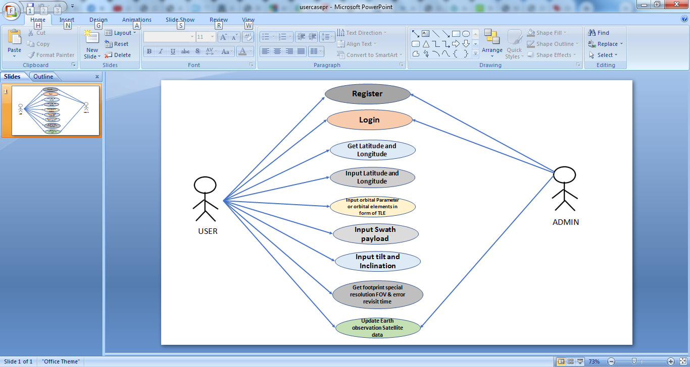
USECASE

Slide 5




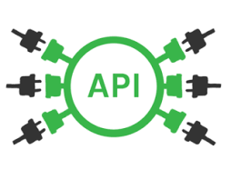




TECHNOLOGY STACK
LIBRARIES
OS, REQUEST, PLATFORM, WMI , RE, LOGGING
DEPENDENCIES
1. PowerShell: PowerShell scripts to handle more in-depth or specific scanning requests
2. API Integration: VirusTotal API , Avast API , CVE Database API

